Slide 1

Food Trend Analysis: Customer Behavior and Market Insights
Submitted by:
Name:N.Nithiksha

Slide 2
INTRODUCTION
The Food Trend Analysis Dashboard provides a comprehensive overview of customer preferences, purchasing behavior, and sales performance across different food categories and platforms. It focuses on understanding how factors like age group, region, season, and payment mode influence overall revenue and order trends.
Through interactive visualizations, the dashboard showcases insights into sales distribution, customer demographics, menu performance, and regional comparisons. It identifies the top-performing platforms, high-revenue regions, and seasonal sales peaks, helping businesses align their strategies with customer demand.
By analyzing data such as total revenue, average ratings, order volume, and seasonal variations, this visualization supports data-driven decision-making. It helps restaurants and food delivery services improve marketing campaigns, optimize menu offerings, and enhance customer satisfaction.

Slide 3
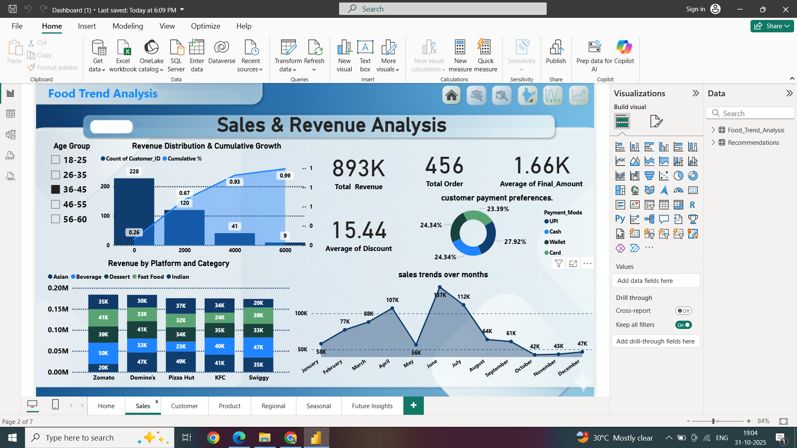
Dashboard 1

Slide 4
1. Revenue Distribution & Cumulative Growth (by Age Group)
Highest customer count: 18–25 age group (228 customers).
Cumulative growth reaches 99% by age 46–55 → shows younger audience dominance.
2. Revenue by Platform and Category
Pizza Hut and KFC generate the most revenue.
Fast Food and Indian cuisines perform best across platforms.
3. Total Revenue / Total Orders / Average Final Amount
Total Revenue: 893K | Orders: 456.
Avg Final Amount: 1.66K → stable medium-value purchases.
4. Average of Discount
Average discount: 15.44%.
Balanced offers encourage customer retention.
5. Customer Payment Preferences (Donut Chart)
UPI (27.92%) most preferred payment mode.
Digital payments dominate over cash.
6. Sales Trends Over Months (Line Chart)
Peak sales: June–July (over 100K).
Lowest sales: October–November → possible off-season period.

Slide 5
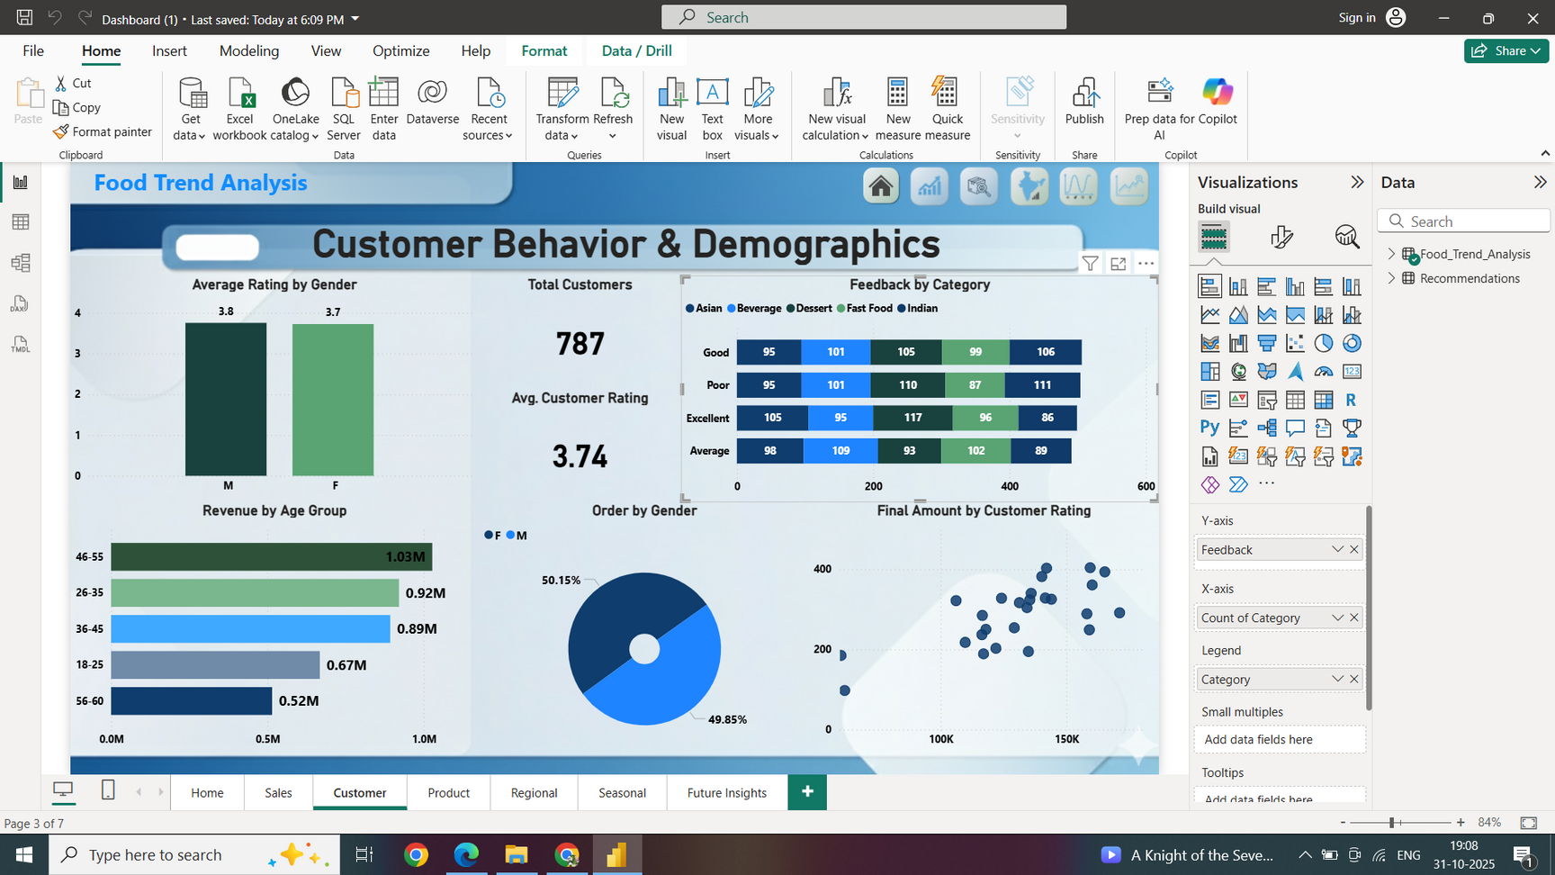
Dashboard 2

Slide 6
1. Average Rating by Gender
Males: 3.8 | Females: 3.7 → almost equal satisfaction levels.
Shows balanced experience across genders.
2. Revenue by Age Group
46–55 age group contributes the highest revenue (1.03M).
Younger age groups (18–25) spend less overall.
3. Total Customers & Average Rating
Total Customers: 787 | Avg Rating: 3.74.
Indicates moderate satisfaction among users.
4. Feedback by Category
Fast Food & Indian get the most “Good” and “Excellent” ratings.
Poor feedback lowest for these categories → strong performance.
5. Order by Gender (Donut Chart)
Male: 50.15% | Female: 49.85% → nearly equal ordering trend.
Gender-based buying behavior is well balanced.
6. Final Amount by Customer Rating (Scatter Plot)
Higher ratings often align with higher spending amounts.
Suggests satisfied customers spend more frequently.

Slide 7
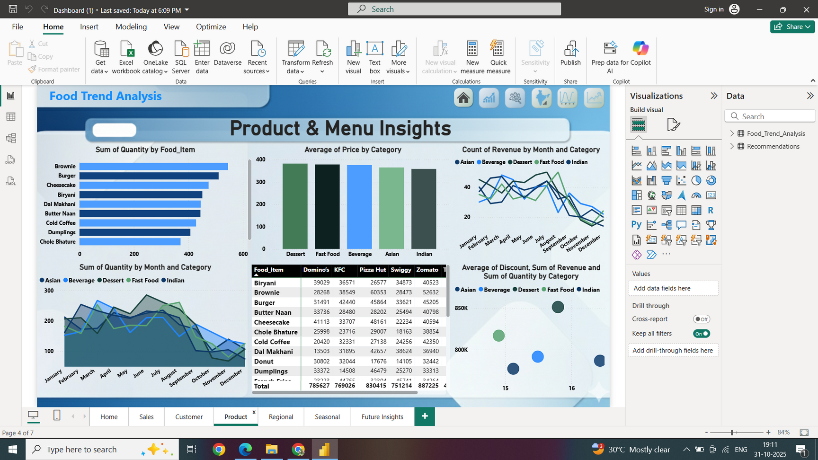
Dashboard 3

Slide 8
1. Sum of Quantity by Food Item
Brownie and Burger are the top-selling items.
Chole Bhature and Dumplings have lower sales volume.
2. Average of Price by Category
Fast Food and Beverage categories have highest average prices.
Asian and Indian cuisines are moderately priced.
3. Count of Revenue by Month and Category
Revenue peaks during mid-year (May–August) across all categories.
Desserts and Fast Food consistently generate high monthly revenue.
4. Sum of Quantity by Month and Category
Fast Food shows highest quantity sold across most months.
Sales decline after August → possible end of seasonal demand.
5. Table (Food Item vs Platform)
Zomato and Pizza Hut contribute the highest revenue totals.
Brownie and Burger dominate across multiple platforms.
6. Average of Discount, Revenue & Quantity by Category (Bubble Chart)
Dessert category has balanced discount and strong revenue.
Fast Food leads in both quantity sold and total revenue.

Slide 9
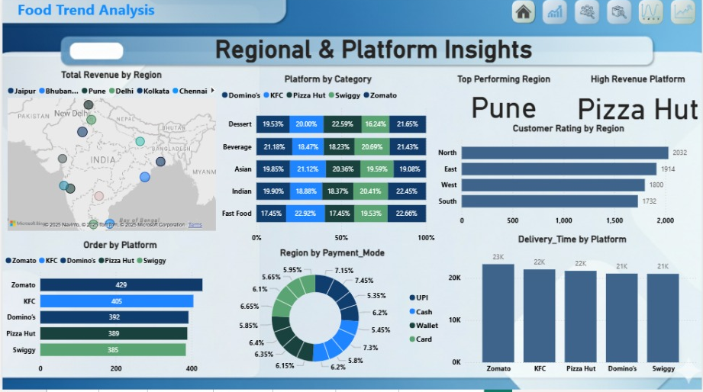
Dashboard 4

Slide 10
1. Total Revenue by Region (Map)
East region generates the highest revenue.
South and West regions show moderate contribution.
2. Platform by Category
Pizza Hut and Zomato perform strongly across all categories.
Fast Food and Beverage dominate platform-wise sales.
3. Top Performing Region
East region leads with the highest customer engagement.
Indicates strong market potential and satisfaction level.
4. High Revenue Platform
Pizza Hut records the highest overall revenue.
Performs well across regions and food categories.
5. Order by Platform
Zomato (429 orders) tops in total orders.
KFC and Pizza Hut follow closely behind.
6. Region by Payment Mode
UPI and Card are the most preferred payment modes.
Cash payments are minimal → indicates digital trend.
7. Delivery Time by Platform
Zomato and KFC have fastest delivery times (~23K sec).
Pizza Hut slightly slower but consistent.

Slide 11
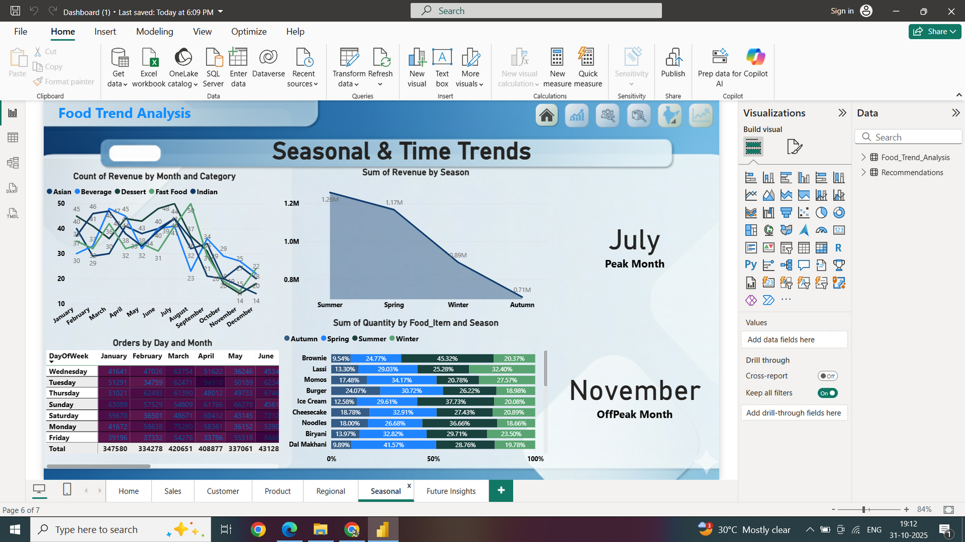
Dashboard 5

Slide 12
1. Count of Revenue by Month and Category
Revenue peaks in July, showing strong mid-year demand.
Fast Food and Beverages dominate most months.
2. Sum of Revenue by Season
Summer season records the highest revenue (1.26M).
Autumn has the lowest sales, showing off-peak activity.
3. Orders by Day and Month
Tuesday and Thursday see the most customer orders.
Weekends show slightly lower but consistent activity.
4. Sum of Quantity by Food Item and Season
Brownies and Ice Cream sell most during summer.
Biryani and Noodles remain steady across seasons.
5. Peak & Off-Peak Months
July – identified as the Peak Month for sales.
November – marked as the Off-Peak Month.

Slide 13
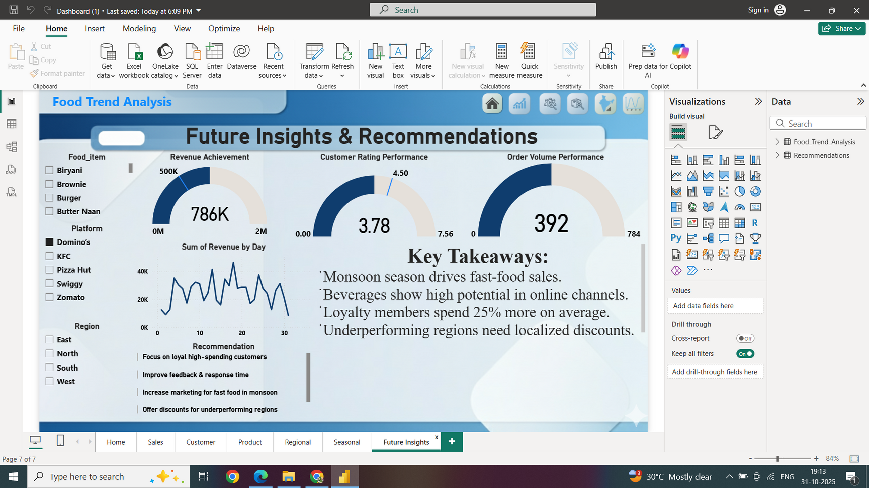
Dashboard 6

Slide 14
1. Revenue Achievement
786K total revenue achieved – strong sales performance.
Consistent daily revenue trend with scope for further growth.
2. Customer Rating Performance
Average rating: 3.78 / 5, showing good satisfaction.
Focus needed on feedback and service improvement.
3. Order Volume Performance
392 average order volume, indicating stable customer activity.
Can be increased with loyalty programs and regional offers.
4. Key Takeaways
Monsoon boosts fast-food sales significantly.
Beverages perform best in online platforms.
Loyalty members spend 25% more on average.
Underperforming regions need targeted discounts.
5. Strategic Recommendations
🎯 Focus on loyal high-spending customers.
🕒 Improve response time and feedback systems.
📈 Market fast food heavily during monsoon season.
💸 Provide localized offers to boost weaker regions.

Slide 15
CONCLUSION
The Food Trend Analysis project successfully provides a complete understanding of customer preferences, market demand, and sales behavior across different food platforms. By integrating data from various sources and visualizing it through Power BI, the dashboard highlights key business insights such as top-performing regions, popular food categories, preferred payment modes, and seasonal sales patterns.
This analysis helps businesses identify growth opportunities, improve customer engagement, and make informed decisions to enhance performance. The findings emphasize the importance of targeted marketing, loyalty programs, and season-based offers to maximize revenue and maintain customer satisfaction.
Overall, the project demonstrates how data visualization and analytics can transform raw data into actionable insights, enabling the food industry to adapt quickly to changing customer trends and make smarter, more strategic business decisions for the future.

Slide 16


